Slide 1
Privacy Chapter 4
Agapitus Iboro, Merit Fontinel, and Jason Holden.

Slide 2
Privacy
What is privacy
What are the first ten amendments called
What's amendment was put in place to give Americans a reasonable expectation of privacy
right of privacy
information privacy.
Notes:
Privacy
the state or condition of being free from being observed or disturbed by other people
Bill of rights
This provides a concept of privacy
Fourth Amendment:
“The right of the people to be secure in their persons, houses, papers, and effects, against unreasonable searches and seizures, shall not be violated, and no Warrants shall issue, but upon probable cause, supported by Oath or affirmation, and particularly describing the place to be searched, and the persons or things to be seized.”
Right of privacy: The right to be left alone
Information privacy: The combination of communications privacy (the ability to communicate with others without those communications being monitored) and data privacy (the ability to limit access to one’s personal data by others).

Slide 3
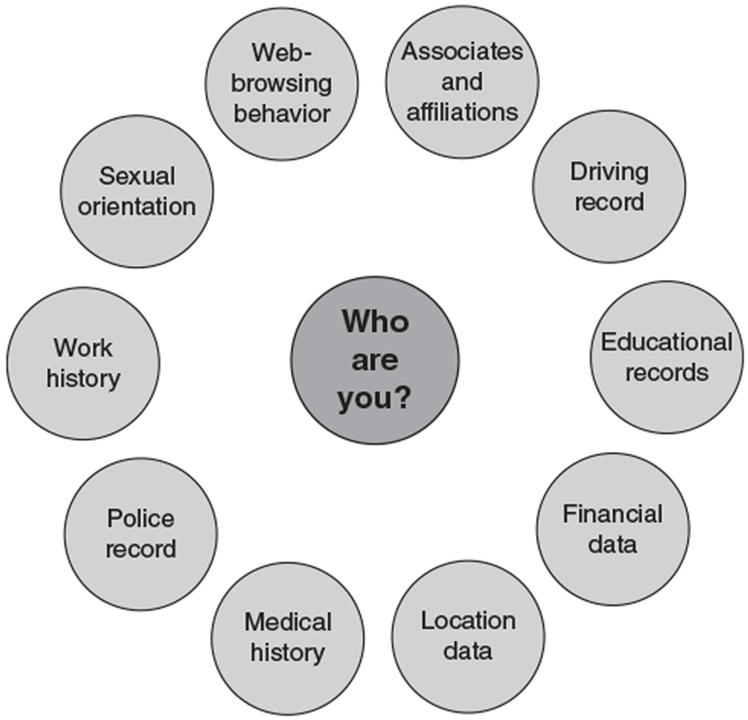
Basis for the collection of data
Notes:
These are the basis for the collection of our data

Slide 4
privacy laws, applications and court rulings
financial data
health information
children’s personal data
electronic surveillance
fair information practices
access to government records
Notes:
These talks about a certain number of legislative acts that affect our privacy. It also addresses the governments invasion of our privacy, and how the legislations that should protect individuals from loss of data is almost nonexistent.

Slide 5
privacy laws, applications and court rulings: Financial data
Who can name a few acts protecting financial data ?
Fair credit reporting act(1970)
Right to financial privacy act (1978)
Gramm-leach-Bliley act (1999)
Fair and accurate credit transactions act (2003)
Notes:
Financial Data
In order to enjoy certain financial products and services like (savings accounts, loans, brokerage accounts) an individual has to disclose his/her private information. Meaning you have information like your password or account number with these companies. These acts tell you what's being done with your data how its protected and if its shared with a third party.

Slide 6
Fair credit reporting act(1970)
Who may access your information
How you can find out what’s in your file
How long data are retained
Prohibits the release of your data to employer or potential employer without your consent
Notes:
This act regulates the operations of credit reporting bureaus, how they collect, store, and use credit information

Slide 7
Right to financial privacy act (1978)
The act only cover disclosures to federal government (must follow procedure)
It Does not cover disclosures to private businesses or state and local governments (doesn't have to follow procedure)
Question
Who sees why the second bullet point could be a problem
Notes:
This act protects financial institutions customers (banks, money order issuers, casinos, card clubs, and credit unions) from unauthorized scrutiny by the federal government.
In the past individuals never had an idea if their information was being turned over to the government for review and customers could not challenge the government.

Slide 8
Gramm-leach-Bliley act (1999)
Financial privacy rule
opt out
opt in
Safeguard rule
Pretexting rule
Notes:
Gramm-Leach-Bliley Act (GLBA): Bank deregulation law that includes three personal privacy rules
Financial privacy rule: Established mandatory guidelines for the collection and disclosure of personal financial data
Opt out: Customers can refuse to give institutions the right to share personal data with third parties
Opt in: Customers who do not take action to opt out automatically opt in
Safeguards rule: Requires financial institutions to document a data security plan to protect personal data
Pretexting rule: Addresses attempts by people to access personal information without proper authority

Slide 9
Fair and accurate credit transactions act (2003)
Example
Someone who suspects their card has been used to purchase unauthorized items.
Notes:
Fair and Accurate Credit Transactions Act: Allows consumers to obtain a free credit report once each year from each of the three primary consumer credit reporting companies (Equifax, Experian, and TransUnion)
Consumers who suspect that they have been or may become a victim of identity theft can place an alert on their credit files

Slide 10
privacy laws, applications and court rulings: Health information
Who can name a few acts protecting health information ?
Health insurance portability and accountability act (19996)
The American recovery and reinvestment act (2009)
Notes:
With the fact that data is stored electronically and can be transferred between different organizations, individuals fear the access of their health information by employers, schools and law enforcement agencies. The laws addressing these issues are …

Slide 11
Health insurance portability and accountability act (19996)
Improve the portability and continuity of health insurance coverage
Reduce fraud, waste, and abuse in health insurance and healthcare delivery
Simplify the administration of health insurance
Notes:
HIPAA includes provisions designed to

Slide 12
The American recovery and reinvestment act (2009)
Bans the sale of health information
Promotes the use of audit trails and encryption
Provides rights of access for patients
Notes:
The American recovery and reinvestment act…

Slide 13
privacy laws, applications and court rulings: children’s personal data
Who can name a few acts protecting children's personal data ?
Family educational rights and privacy act (1974)
Children’s online privacy protection act (1998)
Notes:
With the high of kids time spent online only a few acts have been put in place to ensure the safe surfing of the internet and these are the …..

Slide 14
Family educational rights and privacy act (1974)
Access educational records maintained by a school
Demand that educational records be disclosed only with student consent
Amend educational records
File complaints against a school for disclosing student records
Notes:
Assigns parents rights regarding their children’s educational records, including rights to:

Slide 15
Children’s online privacy protection act (1998)
This act Gives parents control over the collection, use, and disclosure of their children’s personal information over the Internet

Slide 16
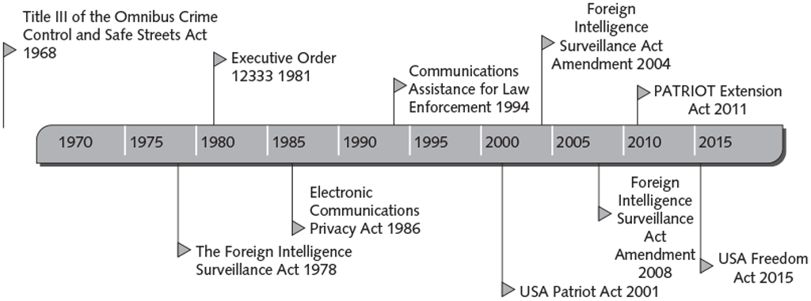
privacy laws, applications and court rulings: electronic surveillance
Who can name a few acts regarding electronic surveillance ?
Notes:
This concept discusses government surveillance, including various forms of electronic surveillance, as well as some of the laws governing those activities.

Slide 17
Title 111 of the omnibus crime control and safe streets act 1968
This is Also known as the Wiretap Act
Who knows what wire tapping is ?
This act Regulates the interception of wire and oral communications
Allows state and federal law enforcement officials to use wiretapping and electronic eavesdropping if a warrant is issued
Notes:
Wire tapping is the practice of connecting a listening device to a telephone line to secretly monitor a conversation

Slide 18
The foreign intelligence surveillance act 1978
Allows surveillance, without court order, within the U.S. for up to a year unless the surveillance will acquire the contents of any communication to which a U.S. citizen, permanent resident, or company is a party
Requires the government to obtain an individualized court order before it can intentionally target a U.S. person anywhere in the world
Notes:
Describes procedures for electronic surveillance and collection of foreign intelligence information in communications between foreign powers and their agents

Slide 19
Executive order 12333 1981
Central intelligence Agency CIA
Defense Intelligence Agency DIA
National security agency NSA
Federal bureau of investigation FBI
Drug enforcement agency DEA
Department of homeland security
Notes:
Identifies the various U.S. governmental intelligence-gathering agencies, and defines what information can be collected, retained, and disseminated by these agencies

Slide 20
Electronic communications privacy act 1986
Protection of communications while in transfer from sender to receiver
Protection of communications held in electronic storage
Prohibition of devices from recording dialing, routing, addressing, and signaling information without a search warrant
Notes:
Law passed as an amendment to Title III of the Omnibus Crime Control and Safe Streets Act; deals with three main issues:

Slide 21
Electronic communications privacy act 1986
National Security Letter (NSL):
Compels holders of your personal records to turn them over to the government
Not subject to judicial review or oversight
NSL gag provision: Prohibits NSL recipients from revealing that the government has requested an individual’s records
Pen register
Trap and trace
Notes:
Issued by the FBI director to an ISP; requires the ISP to provide various data and records about a service subscriber.
Pen register: A device that records electronic impulses to identify the numbers dialed for outgoing calls
Trap and trace: A device that records the originating number of incoming calls for a particular phone number

Slide 22
Communications assistance for law enforcement 1994
Required the telecommunications industry to build tools into its products for use by federal investigators, after obtaining a court order, to intercept communications

Slide 23
USA patriot act 2001
Increased their ability to search telephone, email, medical, financial, and other records
Passed five weeks after the terrorist attacks of September 11, 2001
Notes:
Gave sweeping new powers to both domestic law enforcement and U.S. international intelligence agencies

Slide 24
Foreign intelligence surveillance act amendment 2004
Authorized intelligence gathering on individuals not affiliated with any known terrorist organization (so-called lone wolves)

Slide 25
Foreign intelligence surveillance act amendment 2008
Granted NSA expanded authority to collect (without court-approved warrants) international communications as they flow through U.S. telecom network equipment and facilities

Slide 26
Patriot extension act 2011
Law that granted a four-year extension of roving wiretaps and searches of business records; also extended authorized intelligence gathering on “lone wolves”

Slide 27
USA freedom act 2015
Terminated NSA’s bulk collection of telephone metadata
Telecommunications providers are now required to hold that data and respond to NSA queries
Notes:
Law passed following revelations by Edward Snowden (a former government contractor who leaked classified information) of secret NSA surveillance programs

Slide 28
privacy laws, applications and court rulings: fair information practices
Who can name a few acts regarding fair information practice ?
Organization for economic co-operation and development for the protection of privacy and transborder flows of personal data (1980)
European union data protection directive (1995)
European-united states privacy shield data transfer program guidelines
General data protection regulation
Notes:
This is a term of guidelines for the collection and use of personal data
Fair information practices form the underlying basis for many national laws addressing data privacy and data protection issues

Slide 29
Organization for economic co-operation and development for the protection of privacy and transborder flows of personal data (1980)
OECD fair information practices guidelines are composed of eight principles:
Collection limitation
Data quality
Purpose specification
Use limitation
Security safeguards
Openness principle
Individual participation
Accountability

Slide 30
European union data protection directive (1995)
Only U.S. companies certified as meeting certain “safe harbor” principles were allowed to process and store data of European consumers and companies
Notes:
Ensures that data transferred to non-European Union countries is protected

Slide 31
European-united states privacy shield data transfer program guidelines
Replaced the Safe Harbor agreement between the U.S. and EU, which was declared invalid by the European Court of Justice
Places stronger obligations on U.S. companies to protect the personal data of EU citizens and requires stronger enforcement by U.S. agencies

Slide 32
General data protection regulation
Organizations anywhere in the world that collect, store, or transfer personal data of EU citizens must ensure their systems and procedures are compliant
Notes:
An EU regulation passed in 2016; designed to strengthen data protection for individuals within the EU

Slide 33
privacy laws, applications and court rulings: access to government records
Who can name a few acts regarding access to government records?
Freedom of information act (1966 amended 1974)
Privacy act (1974)
Notes:
Since the government can store data about each and every one of use, the freedom of information act enables the public to gain access to certain government records and the
Privacy act stops the government from concealing the existence of any data record keeping system.

Slide 34
Freedom of information act (1966 amended 1974)
Two basic requirements for a FOIA request:
The request must not require wide-ranging, unreasonable, or burdensome searches for records
The request must be made according to procedural regulations published in the Federal Register
Notes:
Grants citizens the right to access certain information and records of federal, state, and local governments upon request

Slide 35
Privacy act (1974)
Prohibits U.S. government agencies from concealing the existence of any personal data record-keeping system
Notes:
Sets rules for the collection, use, and dissemination of personal data kept by federal agencies

Slide 36
key privacy and anonymity issues
consumer profiling
electronic discovery
workplace monitoring
advanced surveillance technology
Notes:
This discusses several current and important privacy issues

Slide 37
key privacy and anonymity issues: consumer profiling
Voluntary methods: Website registrations, survey, contests, and social media
Cookies
Tracking software
Notes:
Information about web surfers can be obtained through the use of:
Cookies: Text files that can be downloaded to the hard drives of users who visit a website, so that the website is able to identify visitors on subsequent visits
Tracking software: Allows a website to analyze browsing habits and deduce personal interests and preferences

Slide 38
key privacy and anonymity issues: consumer profiling
Criticisms of consumer profiling:
Personal data may be gathered and sold to other companies without the permission of consumers who provide the data
Risk of a data breach: The unintended release of sensitive data or the access of sensitive data (e.g., credit card numbers or Social Security numbers) by unauthorized individuals
Risk of identity theft: The theft of personal information, which is then used without the owner’s permission—often to commit fraud or other crimes

Slide 39
key privacy and anonymity issues: electronic discovery
Electronic discovery (e-discovery)
Electronically stored information
Predictive coding
Notes:
Electronic discovery (e-discovery): The collection, preparation, review, and production of electronically stored information for use in criminal and civil actions
Electronically stored information (ESI): Any form of digital information stored on any form of electronic storage device
Predictive coding: A process that couples human guidance with computer-driven concept searching in order to “train” document review software to recognize relevant documents

Slide 40
key privacy and anonymity issues: workplace monitoring
Cyber loafing
Private employers may legally monitor employees’ use of any employer-provided mobile phone or computing device
The Fourth Amendment does not limit how a private employer treats its employees
State privacy statutes tend to favor employers over employees
Notes:
Using the Internet for purposes unrelated to work, such as posting to Facebook, sending personal emails or texts, or shopping online

Slide 41
key privacy and anonymity issues: Advanced surveillance technology
Camera surveillance
Used in major cities around the world to deter crime and terrorist activities
Criticism: Such scrutiny is a violation of civil liberties and the cost of the equipment and people required to monitor the video feeds is excessive

Slide 42
key privacy and anonymity issues: Advanced surveillance technology
Vehicle event data recorder
Purposes:
To capture and record data to make changes to improve vehicle performance
For use in a court of law to determine what happened during a vehicle accident
Notes:
A device that records vehicle and occupant data for a few seconds before, during, and after any vehicle crash severe enough to deploy the vehicle’s air bags

Slide 43
key privacy and anonymity issues: Advanced surveillance technology
Stalking app
Performs location tracking, records calls, views text messages sent or received, and records the URLs of any website visited on the phone
Illegal to install the software on a phone without the permission of the phone owner
Notes:
Software that can be loaded onto a cell phone or smartphone

Slide 44
questions

